Slide 1

MobileNets
Efficient Convolutional Neural Networks
for Mobile Vision Applications
Nashash David
Dermer bar
Feitsvaig Bradley

Slide 2
introduction
Convolutional neural networks have become ubiquitous in computer vision.
Deeper and more complicated networks in order to achieve higher accuracy
Improve accuracy are not necessarily making networks more efficient with respect to size and speed.

Slide 3
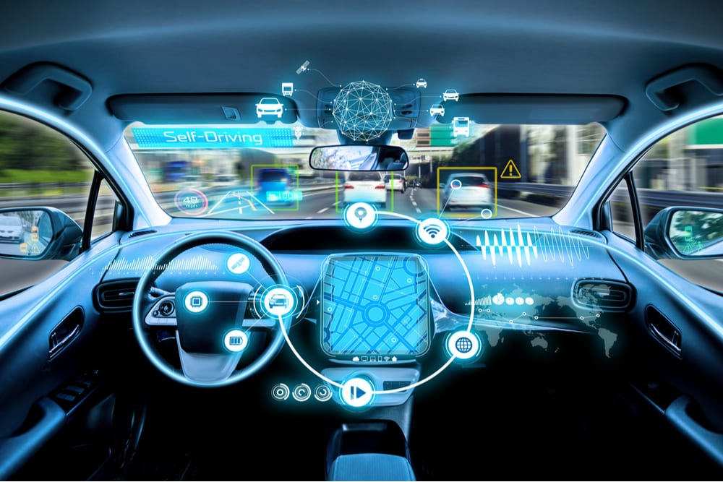
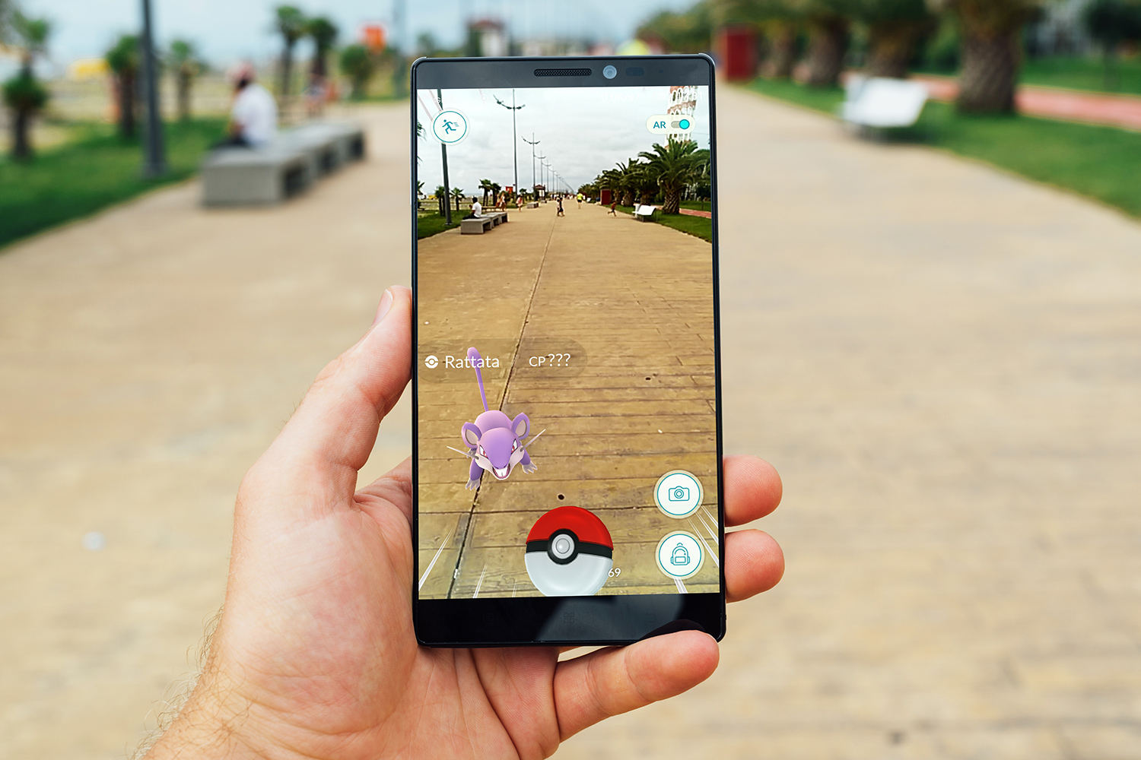
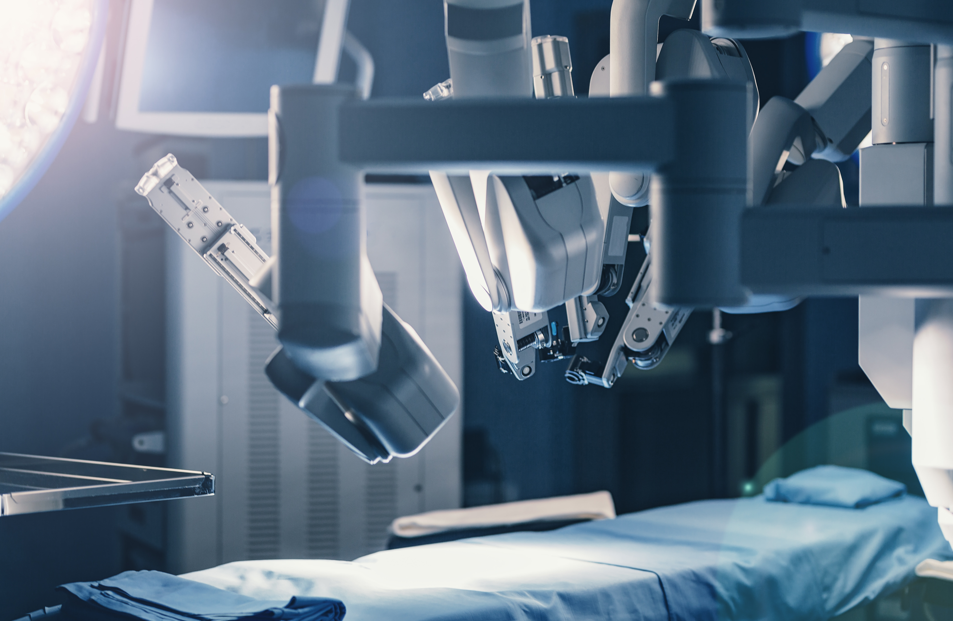
introduction
Mobile and embedded vision applications:
Robotics.
Autonomous vehicles.
Augmented reality.
Required
Efficiency – in some cases can saves live.
Low power
Real time

Slide 4
Mobile-nets
Use depth-wise separable convolutions to build light weight deep neural networks.
Two hyper-parameters:
Width multiplier.
Resolution multiplier.
Allow the model builder to define the right sized model for their application.

Slide 5
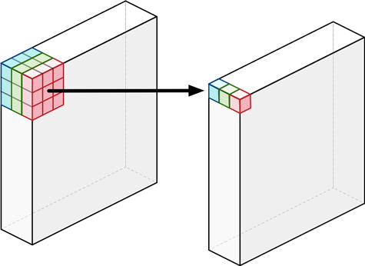
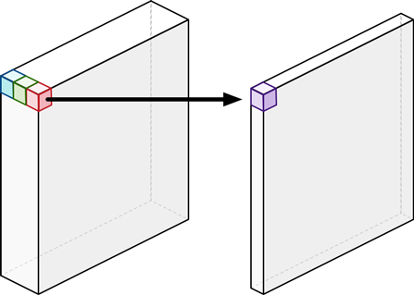
depth-wise separable convolutions
Depthwise Convolution
2 Layers:
Depthwise Convolution
Pointwise Convolution
Pointwise Convolution
Image from http://machinethink.net/blog/googles-mobile-net-architecture-on-iphone/

Slide 6
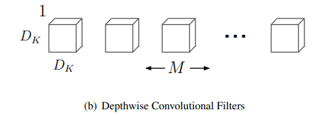
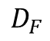
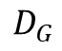
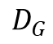
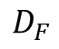
Depthwise Convolution
M
M
$$D_{F}$$
$$D_{G}$$
$$D_{F}$$
$$D_{G}$$
(b) Depthwise Convolution Filters image cropped from the main article

Slide 7
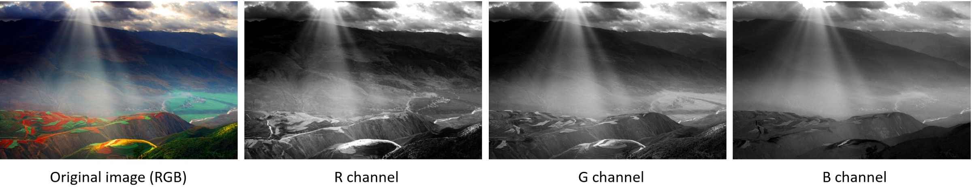
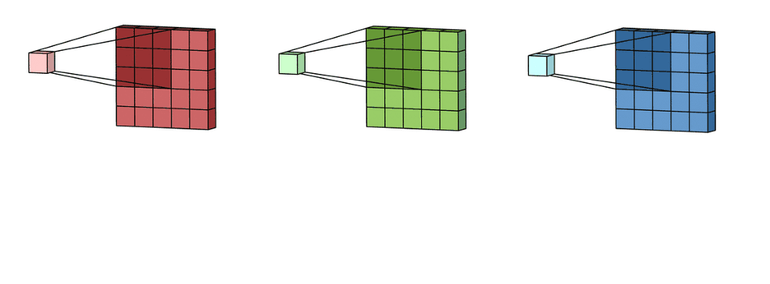
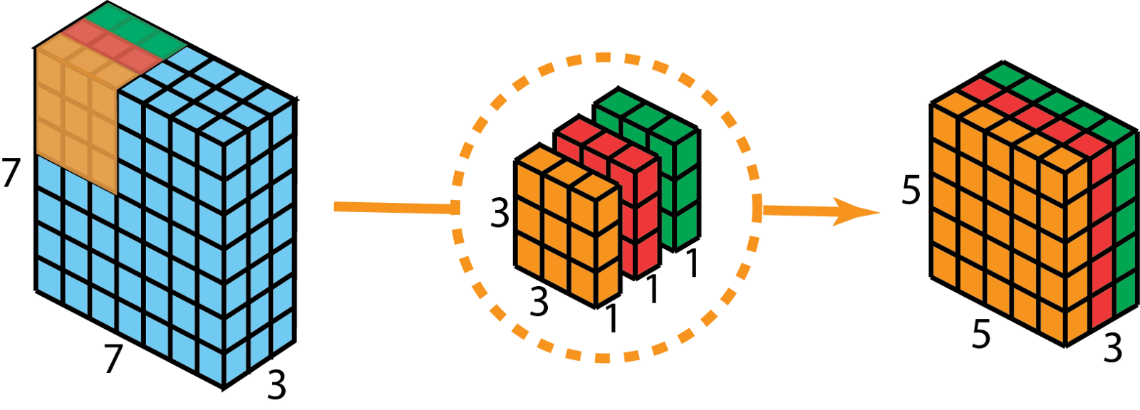
Depthwise Convolution
Animation and images from https://towardsdatascience.com/a-comprehensive-introduction-to-different-types-of-convolutions-in-deep-learning-669281e

Slide 8
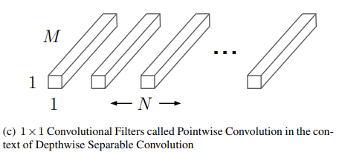
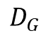
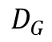
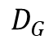
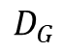
Pointwise Convolution
Depthwise convolution only filters input channels, it does not combine them to create new features.
Pointwise Convolution applies 1X1XM convolution to create a linear combine the outputs the Depthwise convolution.
M
$$D_{G}$$
N
$$D_{G}$$
$$D_{G}$$
$$D_{G}$$
(c) image cropped from the main article

Slide 9
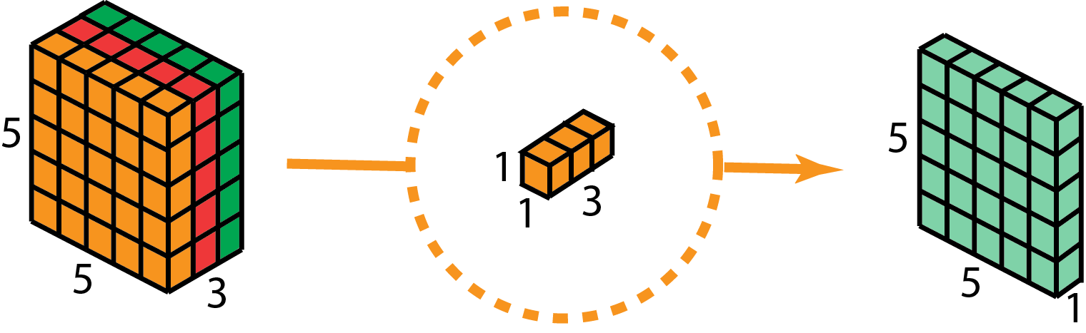
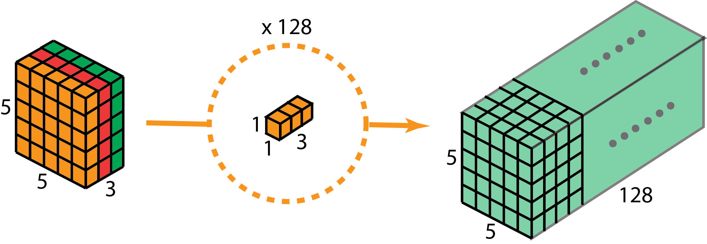
Pointwise Convolution
Images from https://towardsdatascience.com/a-comprehensive-introduction-to-different-types-of-convolutions-in-deep-learning-669281e

Slide 10
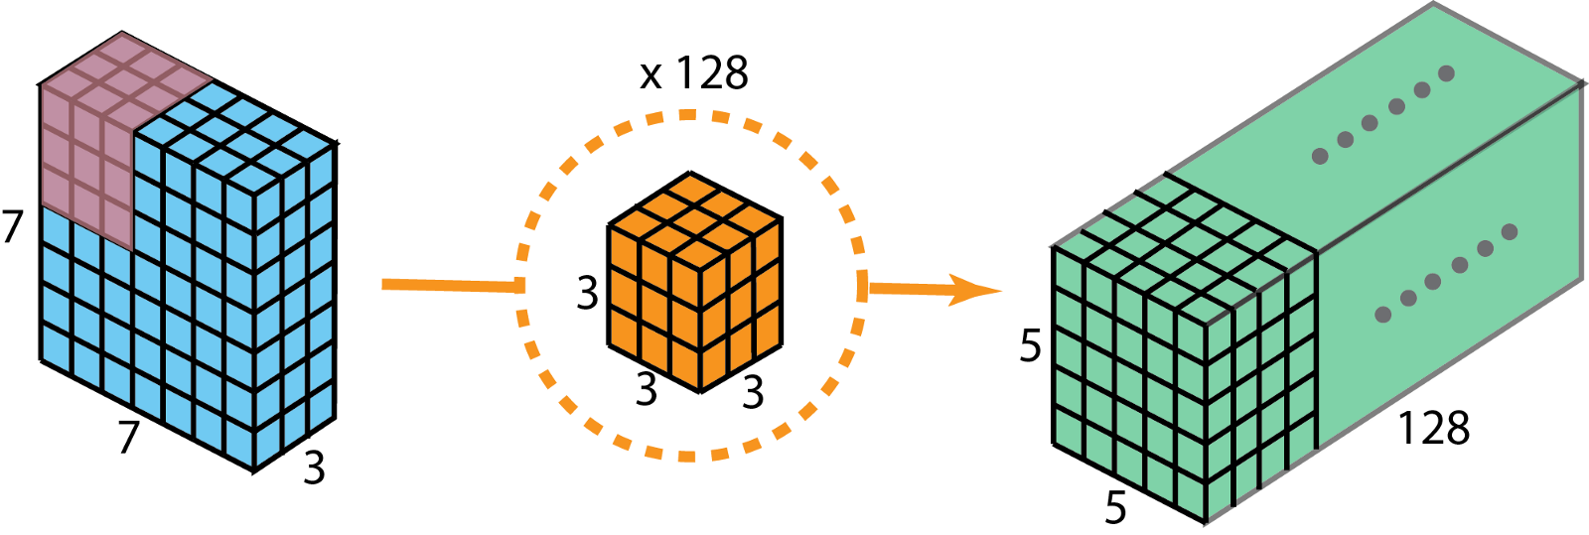
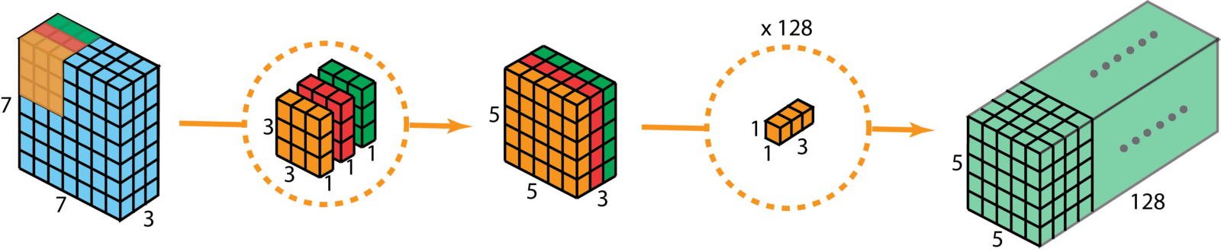
depth-wise separable convolutions VS STANDART CONVOLUTION
STANDART CONVOLUTION
depth-wise separable convolutions
Images from https://towardsdatascience.com/a-comprehensive-introduction-to-different-types-of-convolutions-in-deep-learning-669281e

Slide 11
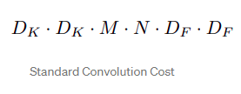
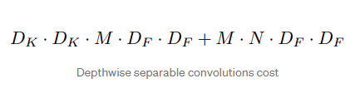
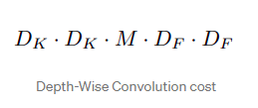
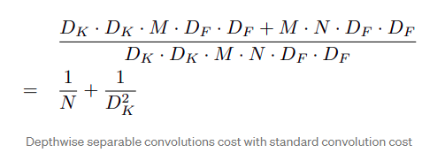
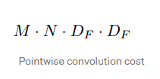
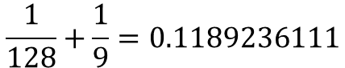
Why is it more efficient?
$$\frac{1}{128}+\frac{1}{9}=0.1189236111$$
In our example:
More efficient in 8.4 times than standard convolution !
Calculation images cropped from the main article

Slide 12
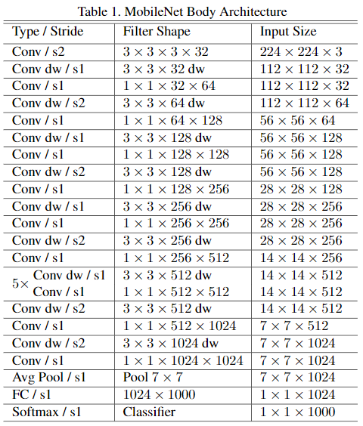
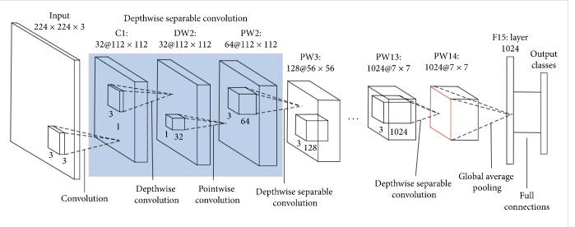
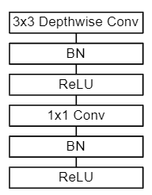
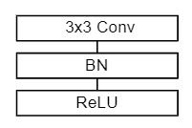
Network Structure and Training

Slide 13
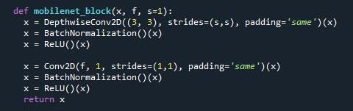
depth-wise separable convolutions code

Slide 14
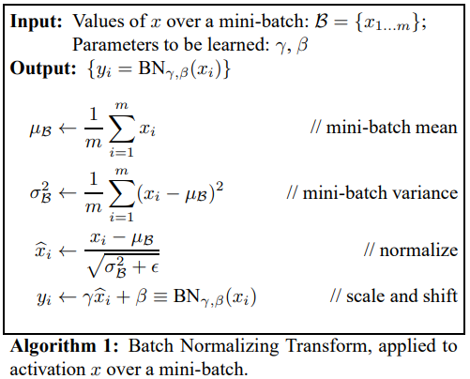
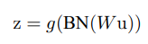
BATCH NORMALIZATION
W is a learned parameter. g is nonlinearity in our case relu.
allows us to use much higher learning rates.
acts as a regularizer.
different elements of the same feature map, at different locations, are normalized in the same way.
REFERENCE S. Ioffe and C. Szegedy. Batch normalization: Acceleratingdeep network training by reducing internal covariate shift.arXiv preprint arXiv:1502.03167, 2015.

Slide 15
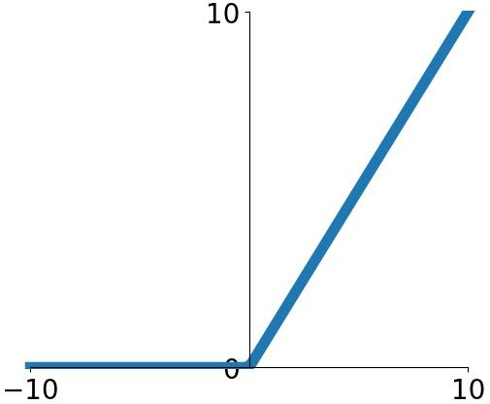
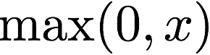

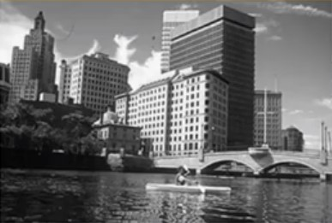
Relu – rectified linear unit
Relu is the activate function that used after each convolution.
Replaces pixel by pixel all negative value by zero.
Increasing the nonlinearity.
relu
Images from https://pydeeplearning.weebly.com/uploads/9/8/4/2/98422174/screen-shot-2016-08-07-at-6-18-19-pm_orig.png

Slide 16
hyper-parameters
A parameter whose value is used to control the learning process.
Trade off between the speed and the accuracy of the model.

Slide 17
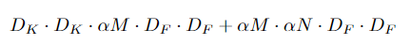
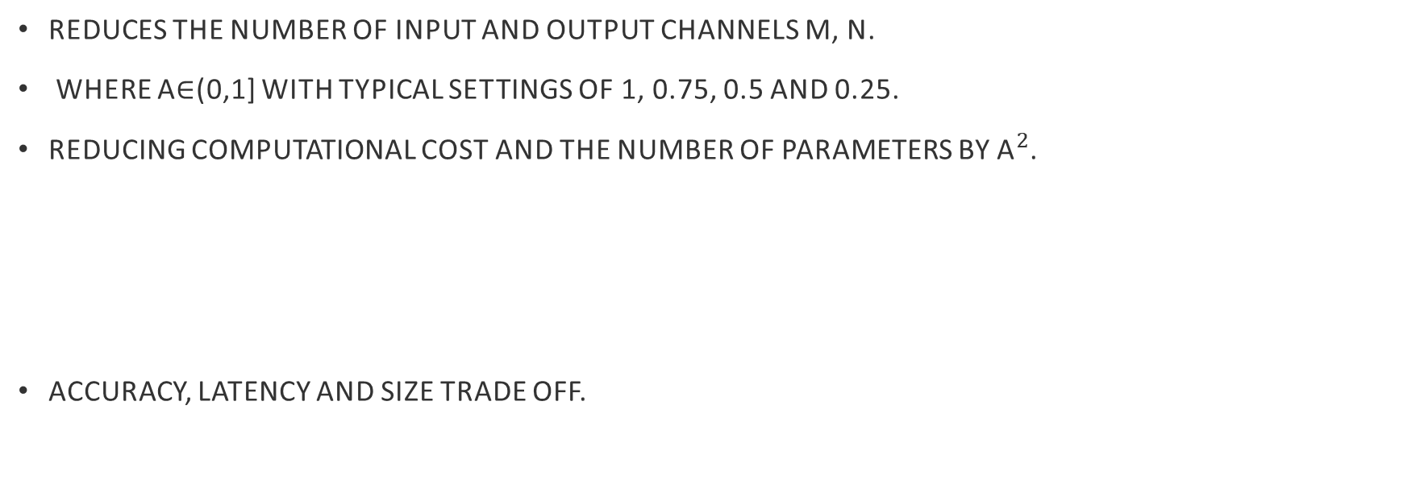
Width Multiplier
Reduces the number of input and output channels m, n.
where α∈(0,1] with typical settings of 1, 0.75, 0.5 and 0.25.
Reducing computational cost and the number of parameters by ${\text{α}}^{2}$.
Accuracy, latency and size trade off.
Image cropped from the main article

Slide 18
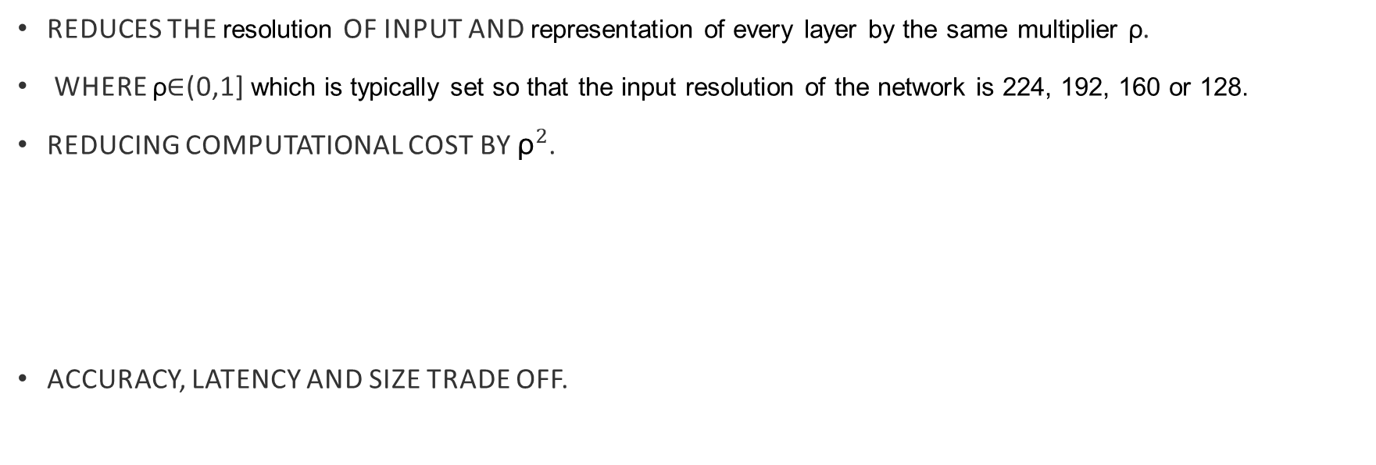
Resolution Multiplier
Reduces the resolution of input and representation of every layer by the same multiplier ρ.
where ρ∈(0,1] which is typically set so that the input resolution of the network is 224, 192, 160 or 128.
Reducing computational cost by ${\text{ρ}}^{2}$.
Accuracy, latency and size trade off.
Image cropped from the main article

Slide 19
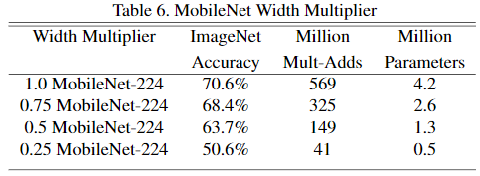
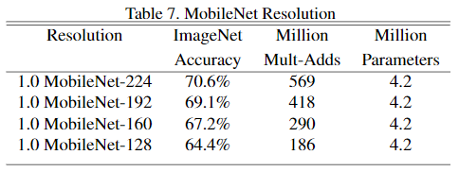
Examples for trade off
Images cropped from the main article

Slide 20
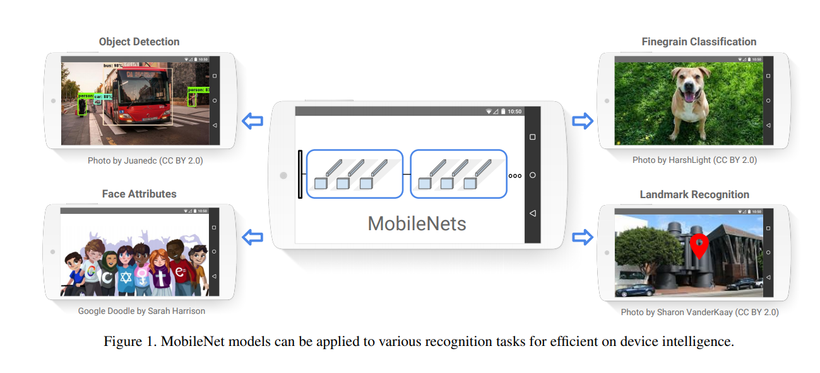
Mobile-nets
Can be used for

Slide 21
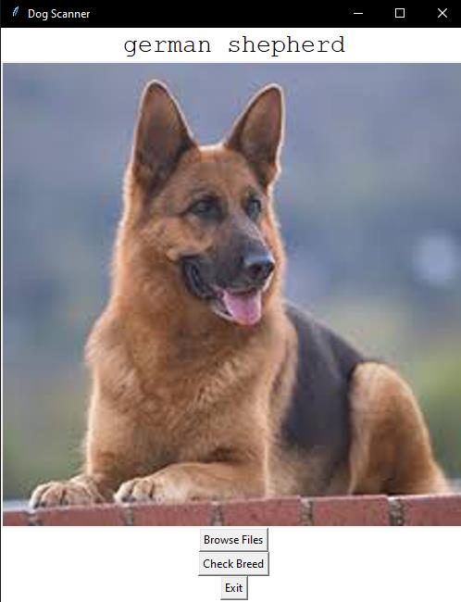
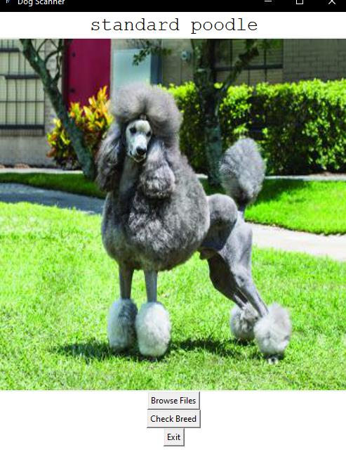
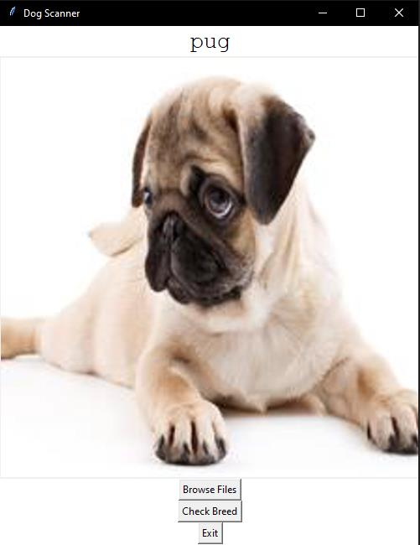
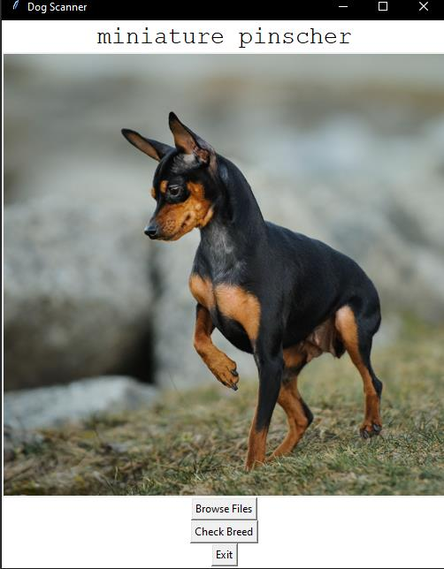
Dog scanner

Slide 22

Dog scanner
MobileNets based
Efficient classification
Light weight application

Slide 23
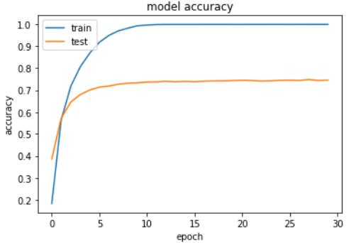
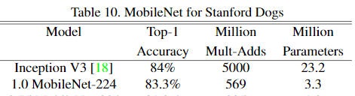
results
Highest val_accuracy 12-15 epochs
loss: 0.0646 - accuracy: 0.9980 - val_loss: 0.9135 - val_accuracy: 0.7364.
Trainable params: 3,329,976
Images cropped from the main article

Slide 24
references
MobileNets: Efficient Convolutional Neural Networks for Mobile Vision Applications; Andrew G. Howard, Menglong Zhu, Bo Chen, Dmitry Kalenichenko, Weijun Wang, Tobias Weyand, Marco Andreetto, Hartwig Adam; 2017
S. Ioffe and C. Szegedy. Batch normalization: Acceleratingdeep network training by reducing internal covariate shift.arXiv preprint arXiv:1502.03167, 2015.
Images from:
https://pydeeplearning.weebly.com/uploads/9/8/4/2/98422174/screen-shot-2016-08-07-at-6-18-19-pm_orig.png
http://machinethink.net/blog/googles-mobile-net-architecture-on-iphone/
https://towardsdatascience.com/a-comprehensive-introduction-to-different-types-of-convolutions-in-deep-learning-669281e

